Slide 1
Software Quality Assurance
Agenda:
Objectives of quality measurement
Classification of software quality metrics
Process metrics
Product metrics
Implementation
Application

Slide 2
Software Quality Assurance
“ You can’t control what you can’t measure” - Tom DeMarco

Slide 3
Software Quality Assurance
What is Measure and Measurement?
Measure
  A quantitative indication of an attribute
    Kilometers is a measure of distance
    Centigrade is a measure of temperature
    Person Hours is a measure of effort
  Measures are the fundamental building blocks of a measurement system
Measurement
  The act of determining a measure of something
  and assigning an exact quantitative value
  4 km, 30º C, 50 Kg

Slide 4
Software Quality Assurance
What is a Metric ?
A relation established between basic measures, which can serve to provide indicator. Usually expressed to indicate efficiency or performance
    Speed (A relation of two different measures speed and time)
    % RBC content
    Effort variance
    Defect Density
Basis for comparison with standards / benchmarks
In software industry a metric shall be used to indicate the performance of the process and product (i.e. software)

Slide 5
Software Quality Assurance
Basic Measures in Software Industry
Size (KLOC/FP)
Effort
Schedule
Defects – Review Defects, Testing defects

Slide 6
Data Collection for metrics
Software Quality Assurance
Operational activities of measurement begin with collecting data
Start collecting data right from the beginning.
Inputs
Requirements
Design
Code &
Unit Test
Integrate
Outputs

Slide 7
Software Quality Assurance
Objectives of quality measurement
To facilitate management control as well as planning and execution of the appropriate managerial interventions:
Could be achieved based on metrics collected
Deviations of actual performance from planned performance
Deviations of actual timetable – schedule and budget performance from planned performance
2. To identify situations that require improvement – preventive or corrective
Could be achieved based on accumulation of metrics regarding the performance of teams, units etc

Slide 8
Software Quality Assurance
Comparison provides the practical basis for SQA improvement
Comparison is done between performance data with indicators – quantitative values, such as
  Defined software quality standards
  Quality targets set for organizations or individuals
  Previous project’s quality achievements
  Average quality levels achieved by other teams in similar conditions
  Industry practice for meeting quality requirements
Software quality metrics – requirements – self study

Slide 9
Software Quality Assurance
Classification of software quality metrics
Software quality metrics fall into a number of categories.
The first category
  a. Process metrics → related to the software development process
  b. Product metrics → related to software maintenance
The second category of metrics
Quality
Timetable
Effectiveness (of error removal and maintenance service)
Productivity

Slide 10
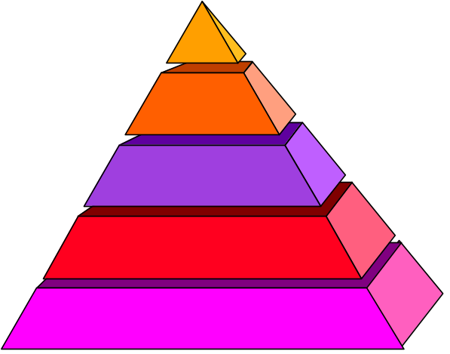
Categories Of Metrics
Process Metrics
Feedback to improve the process, productivity
Project Metrics
Track project progress
Product Metrics
Track quality of product

Slide 11
Software Quality Assurance
Software quality metrics uses one of the two following measures for system size:
KLOC → Kilo Line Of Code
Specific to the programming language or development tool used
2. Function Point → measure of resources required to develop a program
Based on functionality specified for the software system

Slide 12
Software Quality Assurance
Process metrics
Categories
Software process quality metrics
Software process timetable metrics
Error removal effectiveness metrics
Software process productivity metrics
Software process quality metrics:
Classified into two classes:
Error density metrics
Error severity metrics
We shall see in detail

Slide 13
Software Quality Assurance
Process metrics
Error density metrics → involves a) software volume (size) b) errors counted
NCE → Number of Code Errors
WCE → Weighted number of Code Errors
“Weight” is defined based on the severity of error
For eg.,
Error Severity | Relative Weight
Low severity | 1
Medium severity | 3
High severity | 9

Slide 14
Software Quality Assurance
For eg., code error summary of a project → 42 low, 17 medium and 11 high
Calculation of NCE (number of code errors) and WCE
Error severity class a | Calculation of NCE b | Calculation of WCE b X c
Low | 42 | 42
Medium | 17 | 51
High | 11 | 99
Total | 70 | 192

Slide 15
Software Quality Assurance
Code | Name | Calculation Formula
CED | Code Error Density | CED = NCE/KLOC
DED | Development Error Density | DED = NDE/KLOC
WCED | Weighted Code Error Density | WCED = WCE/KLOC
WCEF | Weighted Code Errors per Function Point | WCEF= WCE/NFP
NCE | Number of code errors detected by code inspection and testing
NDE | Total number of development errors (design and code)
WCE | Weighted Code errors detected

Slide 16
Software Quality Assurance
An example:
A s/w development organization applies two alternative metrics for calculation of Code Error Density: a) CED b)WCED.
The organization decides unacceptable quality as CED > 2 and WCED > 4
The s/w size is 40 KLOC
Refer Weighted Code Error table
METRICS | Calculation of Code Error Density | Calculation of WCED
NCE | 70 | -
WCE | - | 192
KLOC | 40 | -
CED (NCE/KLOC) | 1.75 | -
WCED (WCE/KLOC) | - | 4.8

Slide 17
Software Quality Assurance
iii. Error removal effectiveness metrics – self study Pg. No. 419
iv. Software process productivity metrics → a) Direct → deals with a project’s human resources productivity
b) Indirect → deals with extent of software reuse. Software reuse substantially affects productivity and effeteness.
Code | Name | Calculation formula
DevP | Development Productivity | DevP= DevH/KLOC
CRe | Code Reuse | CRe = ReKLOC/KLOC
DocRe | Documentation Reuse | DocRe=ReDoc/NDoc

Slide 18
Software Quality Assurance
Product Metrics
Refers to the software system’s operational phase
Dev. Organization has to provide customer service during the operational phase
There are two types: a) Help Desk Service
  b) Corrective maintenance
  (Self study)

Slide 19
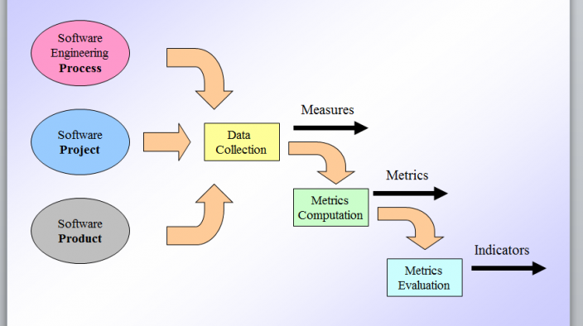
Software Quality Assurance

Slide 20
Software Quality Assurance
Definition of new software quality metrics
Involves a four-stage process
Definition of attributes to be measured: dev team productivity, post-release defect density etc.
Definition of metrics that measure the required attributes
Determination of comparative target values based on standards, previous performance etc.
Determination of metrics application processes
  Reporting method including frequency
  Metrics data collection method

Slide 21
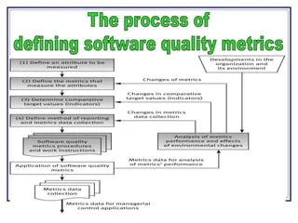
Refer the fig 21.1 Pg. 429

Slide 22
Software Quality Assurance
The process of applying a metric or a set of metrics is similar to the implementation of new procedure or methodologies.
It involves:
Assigning responsibility for metrics data collection and reporting
Instruction of the team regarding the new metrics
Follow-up includes:
  Support for solving application problems
  Control of metrics reporting – completeness and accuracy
Updates and changes of metrics definition according to past performance

Slide 23
Software Quality Assurance
For the metrics data to be a valuable part of the SQA process, statistical analysis is required.
Statistical tools provide us two levels of support
Descriptive statistics → mean, median and mode as well use of distribution graphs, histograms etc
  See the template
  Defect Removal Efficiency Template
Analytical statistics → T-test, Chi-square test etc. Difficult in software industry

Slide 24
Software Quality Assurance
Limitations of software metrics:
Budget constraints in allocating the necessary resources → manpower, funds,
Human factors → opposition of employees to evaluation of their activities
Uncertainty regarding the data’s validity, partial and biased reporting

Slide 25
Software Quality Assurance
The main factors affecting the development process parameters
Programming style → “wasteful” code increase the volume of the code (KLOC)
Volume of the documentation comments in the code → affects the size
Software complexity → complex modules require more dev. time compared to simple modules
Percentage of reused code → more percentage…decrease in defects
Professionalism of design review and testing team
The main factors affecting the product (maintenance) parameters → self study

